Slide 1
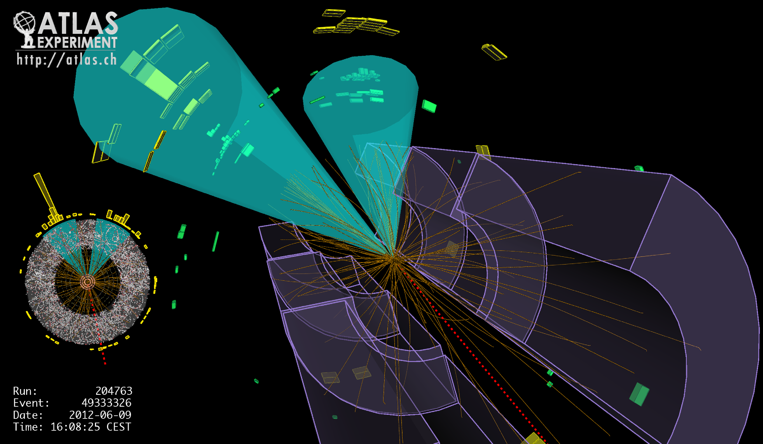
Lecture #11
Prof. Dr. Florencia Canelli
Universität Zürich
Elementary particle physics - PHY451
HS2016

Slide 2
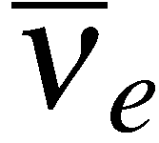
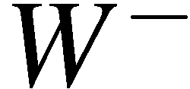
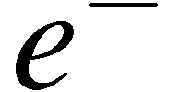
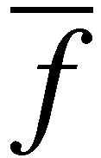

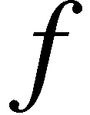
Z boson decay : Γ_{Z}
In W-boson decay only had to consider one helicity combination of (assuming we
can neglect final state masses: helicity states = chiral states)
W-boson couples:
to LH particles
and RH anti-particles
But Z-boson couples to LH and RH particles (with different strengths)
Need to consider only two helicity (or more correctly chiral) combinations:
This can be seen by considering either of the combinations which give zero
e.g.

Slide 3
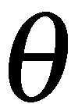
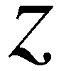
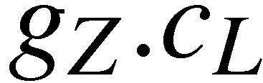
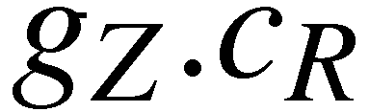
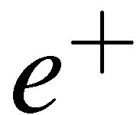
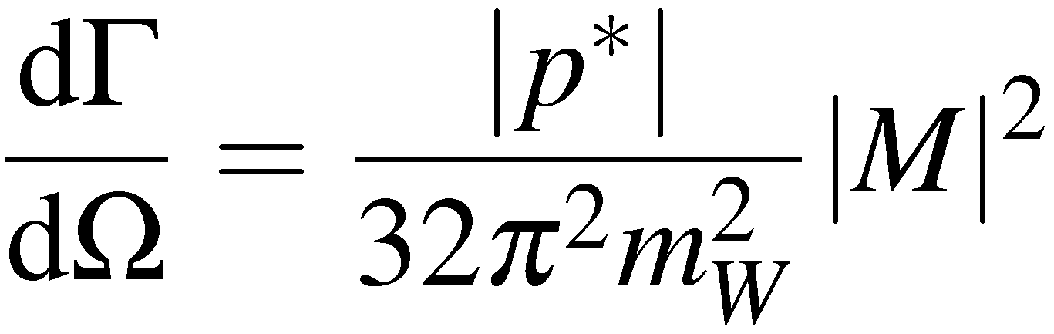
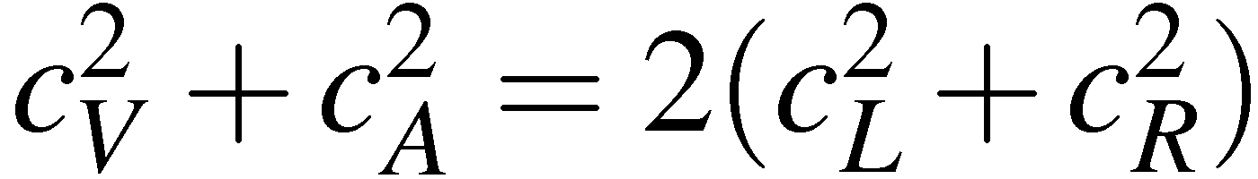
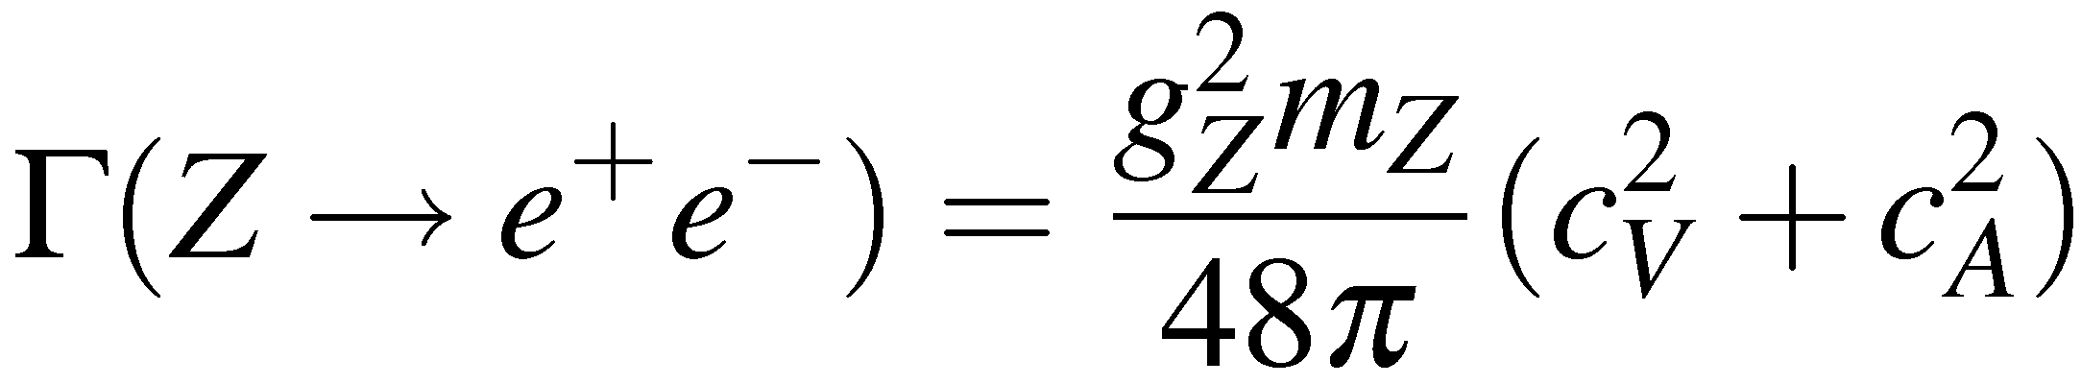
In terms of left and right-handed combinations need to calculate:
For unpolarized Z bosons:
average over polarization
Using
and

Slide 4
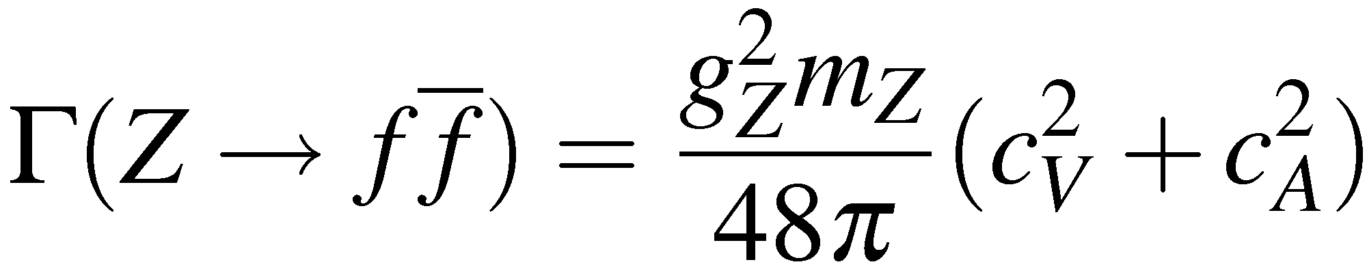
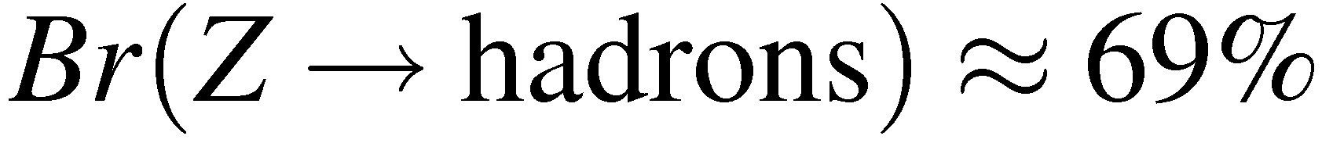
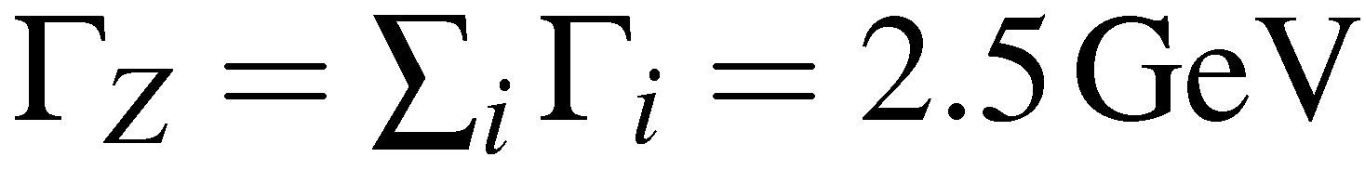
Z branching ratios
(Neglecting fermion masses) obtain the same expression for the other decays
Using values for c_{V} and c_{A} on page 471 obtain:
The Z Boson therefore predominantly decays to hadrons
Mainly due to factor 3 from colour
Also predict total decay rate (total width)
Experiment:

Slide 5
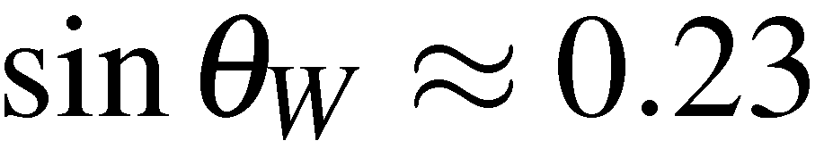
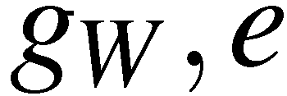
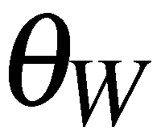
The Standard Model (so far)
The Standard Model interactions are mediated by spin-1 gauge bosons
The form of the interactions are completely specified by the assuming an
underlying local phase transformation GAUGE INVARIANCE
U(1)_{em}
QED
SU(2)_{L}
Charged Current Weak Interaction + W³
SU(3)_{col}
QCD
In order to “unify” the electromagnetic and weak interactions, introduced a
new symmetry gauge symmetry : U(1) hypercharge
U(1)_{Y}
B_{μ}
The physical Z boson and the photon are mixtures of the neutral W boson
and B determined by the Weak Mixing angle
Have we really unified the EM and Weak interactions ? Well not really…
Started with two independent theories with coupling constants
Ended up with coupling constants which are related but at the cost of
introducing a new parameter in the Standard Model
Interactions not unified from any higher theoretical principle… but it works!

Slide 6
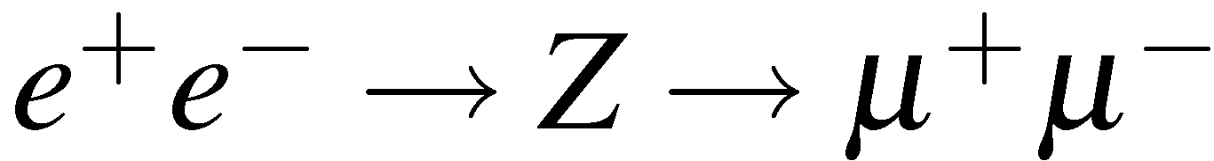
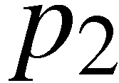
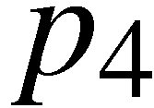
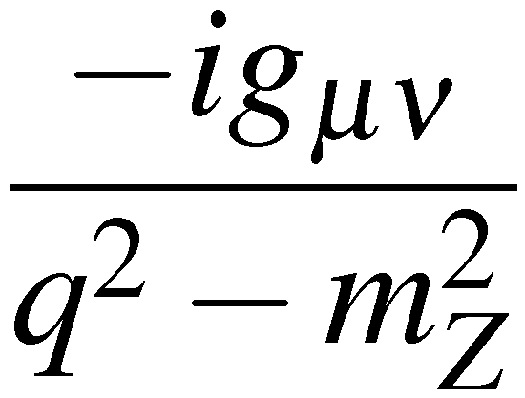


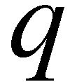
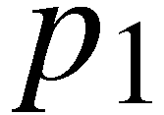
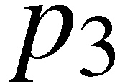
The Z resonance
Feynman rules for the diagram below give:
e⁺
μ⁺
e⁺e⁻ vertex:
Ζ
Z propagator:
e–
μ–
μ⁺μ⁻ vertex:
Convenient to work in terms of helicity states by explicitly using the Z coupling to
LH and RH chiral states (ultra-relativistic limit so helicity = chirality)
LH and RH projections operators

Slide 7
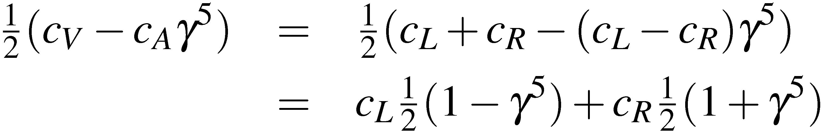
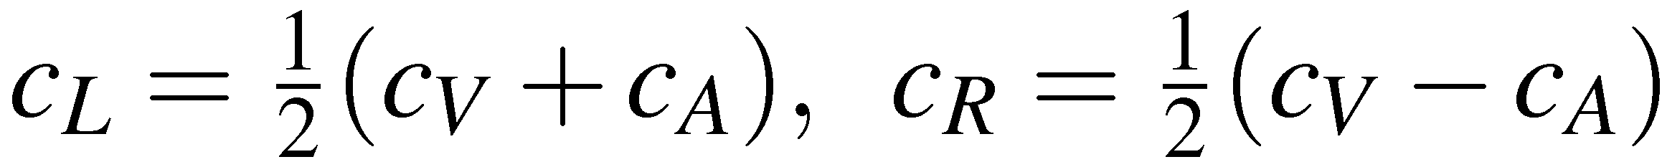
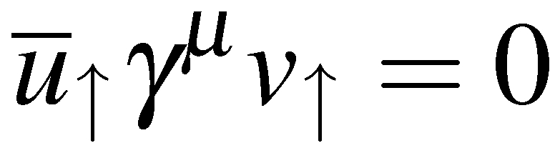
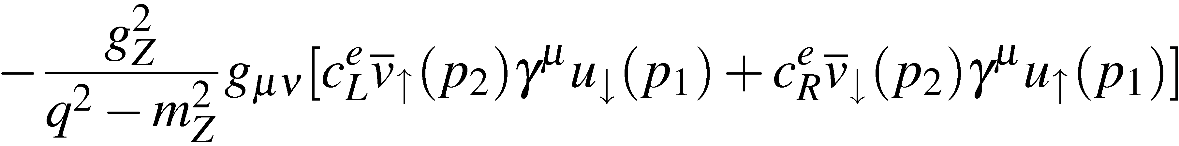
hence
and
with
Rewriting the matrix element in terms of LH and RH couplings:
Apply projection operators remembering that in the ultra-relativistic limit
For a combination of V and A currents, etc, gives four orthogonal
contributions

Slide 8
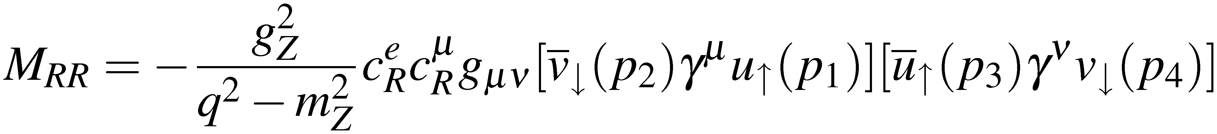
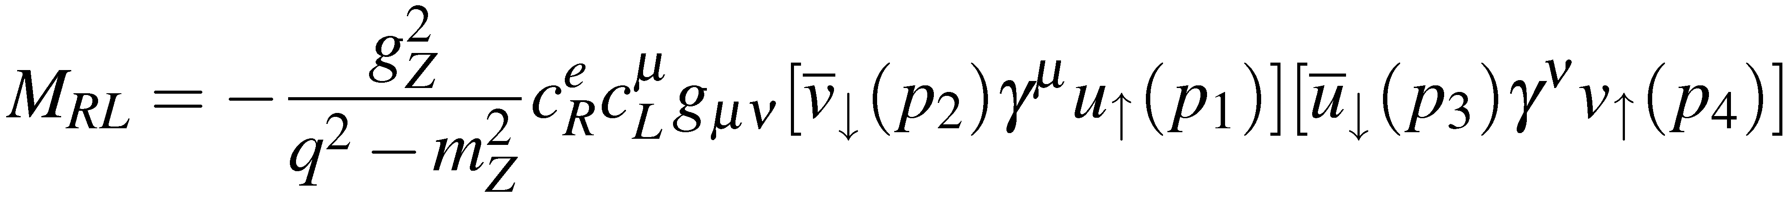
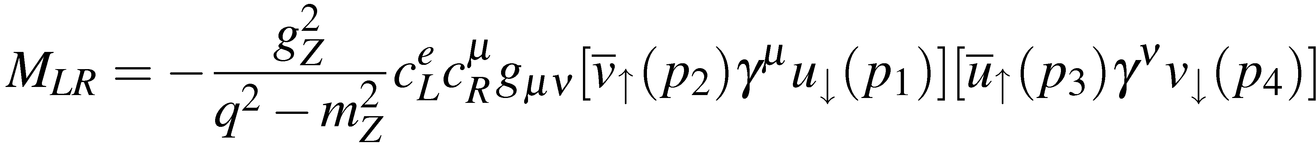
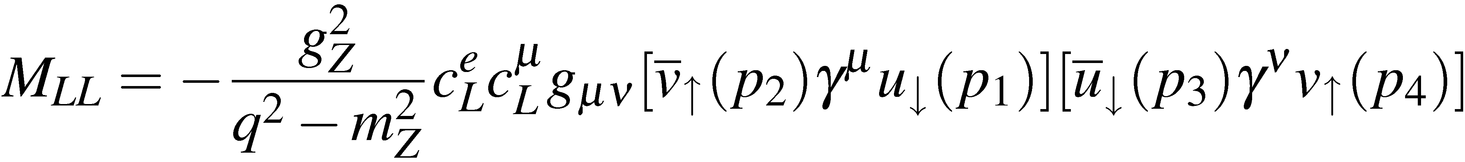
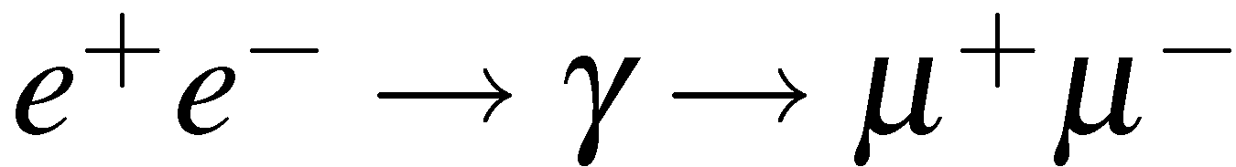
Sum of 4 terms
μ–
e–
e⁺
μ⁺
μ–
e–
e⁺
μ⁺
μ–
e–
e⁺
μ⁺
μ–
e–
e⁺
μ⁺
Remember: the L/R refer to the helicities of the initial/final state particles
Fortunately we have calculated these terms before when considering
giving:
etc.

Slide 9
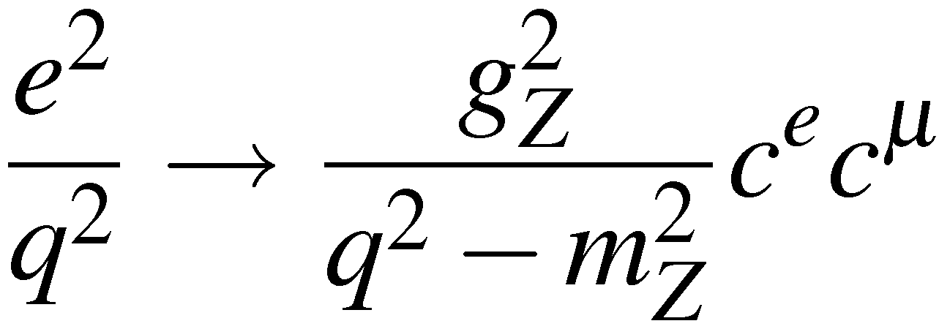
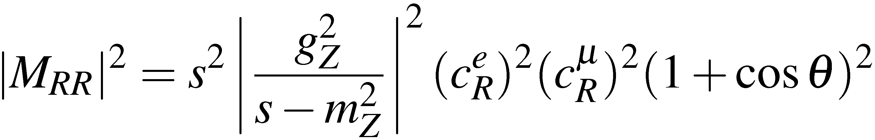
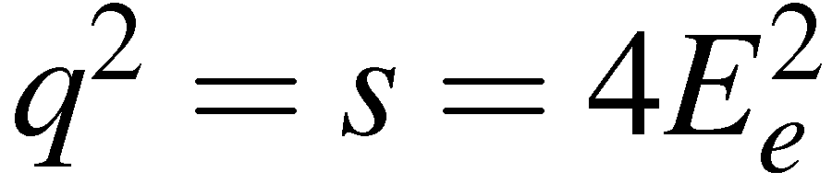
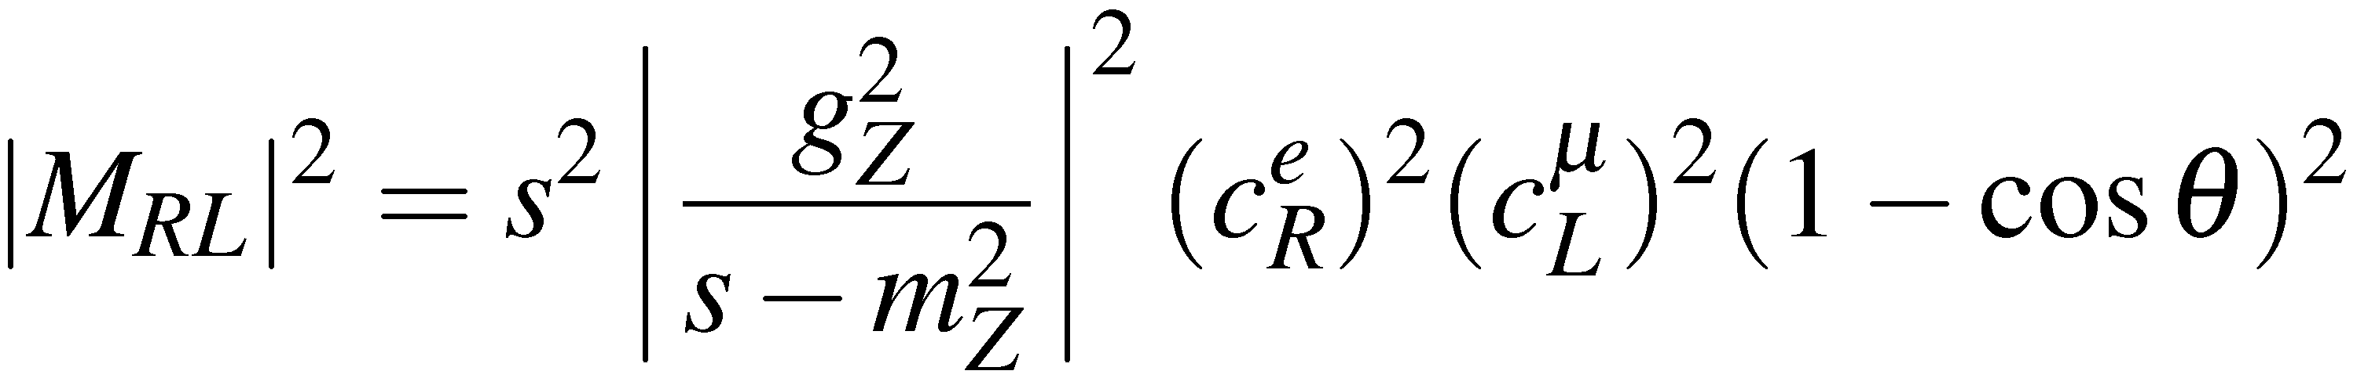


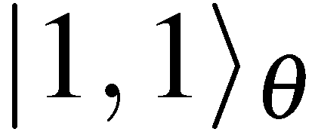
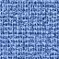
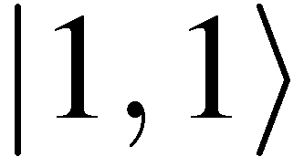
Applying the QED results to the Z exchange with
gives:
where
As before, the angular dependence of the matrix elements can be understood
in terms of the spins of the incoming and outgoing particles e.g.
M_{RR}
μ–
e–
e⁺
μ⁺
-1
cosθ
+1

Slide 10
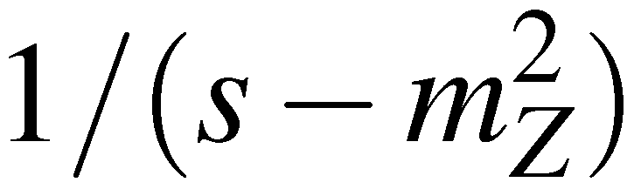
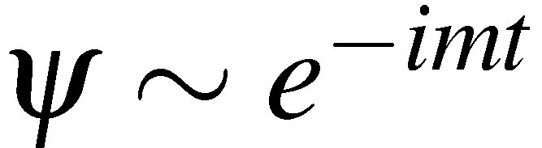
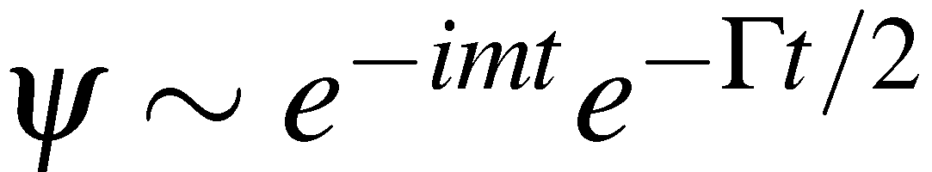
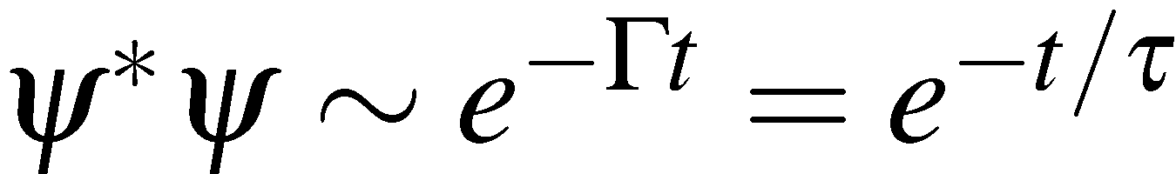
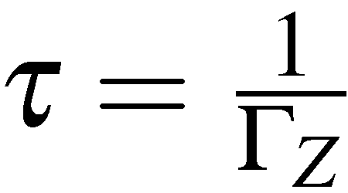
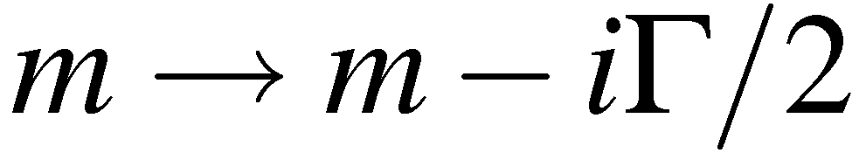
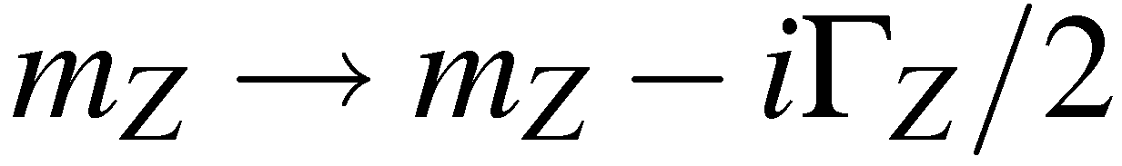


The Breit-Wigner resonance
Need to consider carefully the propagator term which
diverges when the C.o.M. energy is equal to the rest mass of the Z boson
To do this need to account for the fact that the Z boson is an unstable particle
For a stable particle at rest the time development of the wave-function is:
For an unstable particle this must be modified to
so that the particle probability decays away exponentially
with
Equivalent to making the replacement
In the Z boson propagator make the substitution:
Which gives:
where it has been assumed that
Which gives

Slide 11








And the Matrix elements become
etc.
In the limit where initial and final state particle mass can be neglected:
Giving:
-1
cosθ
+1
μ–
Because , the
differential cross section is asymmetric, i.e. parity
violation (although not maximal as was the case
for the W boson).
e–
e⁺
μ⁺

Slide 12



Cross section with unpolarized beams
To calculate the total cross section need to sum over all matrix elements and
average over the initial spin states. Here, assuming unpolarized beams (i.e. both
e⁺ and both e⁻ spin states equally likely) there a four combinations of
initial electron/positron spins, so
The part of the expression {…} can be rearranged:
(1)
and using
and

Slide 13



Hence the complete expression for the unpolarized differential cross section is:
Integrating over solid angle
and
Note: the total cross section is proportional to the sums of the squares of the
vector- and axial-vector couplings of the initial and final state fermions

Slide 14





Connection to the Breit-Wigner formula
Can write the total cross section
in terms of the Z boson decay rates (partial widths)
and
Writing the partial widths as etc., the total cross section
can be written
(2)
where f is the final state fermion flavour

Slide 15
Electroweak measurement at LEP
The Large Electron Positron (LEP) Collider at CERN (1989-2000) was designed
to make precise measurements of the properties of the Z and W bosons.
26 km circumference accelerator
straddling French/Swiss boarder
Electrons and positrons collided at
4 interaction points
4 large detector collaborations (each
with 300-400 physicists):
ALEPH,
DELPHI,
L3,
OPAL
Aleph
L3
Opal
Delphi
e⁺
e⁻
Basically a large Z and W factory:
1989-1995: Electron-Positron collisions at √s = 91.2 GeV
17 Million Z bosons detected
1996-2000: Electron-Positron collisions at √s = 161-208 GeV
30000 W⁺W⁻ events detected

Slide 16









e⁺e⁻ annihilation in Feynman diagrams
In general e⁺e⁻ annihilation
involves both photon and
Z exchange : + interference
Well below Z: photon
exchange dominant
At Z resonance: Z
exchange dominant
High energies:
WW production

Slide 17








Cross section measurements
At Z resonance mainly observe four types of event:
Each has a distinct topology in the detectors, e.g.
To work out cross sections, first count events of each type
Then need to know “integrated luminosity” of colliding beams, i.e. the
relation between cross-section and expected number of interactions

Slide 18






To calculate the integrated luminosity need to know numbers of electrons and
positrons in the colliding beams and the exact beam profile
- very difficult to achieve with precision of better than 10%
Instead “normalise” using another type of event:
Use the QED Bhabha scattering process
QED, so cross section can be calculated very precisely
Very large cross section – small statistical errors
Reaction is very forward peaked – i.e. the
electron tends not to get deflected much
Photon propagator
Count events where the electron is scattered in the very forward direction
known from QED calc.
Hence all other cross sections can be expressed as
Cross section measurements
Involve just event counting !

Slide 19









Measurements of the Z line shape
Measurements of the Z resonance lineshape determine:
: peak of the resonance
: FWHM of resonance
: Partial decay widths
: Number of light neutrino generations
Measure cross sections to different final states versus C.o.M. energy
Starting from
(3)
maximum cross section occurs at with peak cross section equal to
Cross section falls to half peak value at which can be seen
immediately from eqn. (3)
Hence

Slide 20






In practise, it is not that simple, QED corrections distort the measured line-shape
One particularly important correction: initial state radiation (ISR)
Initial state radiation reduces the centre-of-mass energy of the e⁺e⁻ collision
Physics Reports, 427 (2006) 257-454
becomes
Measured cross section can be written:
Probability of e+e- colliding with C.o.M. energy
E when C.o.M energy before radiation is E
Fortunately can calculate very
precisely, just QED, and can then obtain
Z line-shape from measured cross section

Slide 21



In principle the measurement of and is rather simple:
run accelerator at different energies, measure cross sections, account for ISR,
then find peak and FWHM
0.002 % measurement of m_{Z} !
To achieve this level of precision – need to know energy of the colliding beams
to better than 0.002 % : sensitive to unusual systematic effects…
Moon:
As the moon orbits the Earth it distorts the rock in the Geneva
area very slightly !
The nominal radius of the accelerator of 4.3 km varies by ±0.15 mm
Changes beam energy by ~10 MeV : need to correct for tidal effects !
Trains:
Leakage currents from the TGV
railway line return to Earth following
the path of least resistance.
Travelling via the Versoix river and
using the LEP ring as a conductor.
Each time a TGV train passed by, a small
current circulated LEP slightly changing
the magnetic field in the accelerator
LEP beam energy changes by ~10 MeV

Slide 22




Number of generations
Total decay width measured from Z line-shape:
If there were an additional 4th generation would expect decays
even if the charged leptons and fermions were too heavy (i.e. > m_{Z}/2)
Total decay width is the sum of the partial widths:
Although don’t observe neutrinos, decays
affect the Z resonance shape for all final states
For all other final states can determine partial decay
widths from peak cross sections:
Physics Reports, 427 (2006) 257-454
Assuming lepton universality:
measured from
Z lineshape
measured from
peak cross sections
calculated
ONLY 3 GENERATIONS (unless a new 4th generation neutrino has very large mass)

Slide 23



Forward-backward asymmetry
We obtained the expression for the differential cross section:
The differential cross sections is therefore of the form:
Define the FORWARD and BACKWARD cross sections in terms of angle
incoming electron and out-going particle
B
F
B
e.g. “backward hemisphere”
F
μ–
μ–
e–
e–
e⁺
e⁺
μ⁺
μ⁺
-1
cosθ
+1

Slide 24




The level of asymmetry about cosθ=0 is expressed
in terms of the Forward-Backward Asymmetry
B
F
Integrating equation (1):
-1
cosθ
+1
Which gives:
This can be written as
with
(4)
Observe a non-zero asymmetry because the couplings of the Z to LH and RH
particles are different. Contrast with QED where the couplings to LH and RH
particles are the same (parity is conserved) and the interaction is FB symmetric

Slide 25







Measured forward-backward asymmetries
Forward-backward asymmetries can only be measured for final states where
the charge of the fermion can be determined, e.g.
OPAL Collaboration,
Eur. Phys. J. C19 (2001) 587-651.
Because sin²θ_{w} ≈ 0.25, the value of
A_{FB} for leptons is almost zero
For data above and below the peak
of the Z resonance interference with
leads to a
larger asymmetry
LEP data combined:
To relate these measurements to the couplings uses
In all cases asymmetries depend on
To obtain could use

Slide 26










Determination of the weak mixing angle
From LEP :
From SLC :
Putting everything
together
includes results from
other measurements
with
Measured asymmetries give ratio of vector to axial-vector Z coupings.
In SM these are related to the weak mixing angle
Asymmetry measurements give precise determination of

Slide 27









W⁺W⁻ production
From 1995-2000 LEP operated above the threshold for W-pair production
Three diagrams “CC03” are involved
W bosons decay either to leptons or hadrons with branching fractions:
Gives rise to three distinct topologies

Slide 28


e⁺e- → W⁺W⁻ cross section
Measure cross sections by counting events and normalising to low angle
Bhabha scattering events
Data consistent with SM expectation
Provides a direct test of vertex
Recall that without the Z diagram the cross section violates unitarity
Presence of Z fixes this problem

Slide 29











W mass and W width
Unlike , the process is not a resonant process
Different method to measure W-boson Mass
Measure energy and momenta of particles produced in the W boson decays, e.g.
Neutrino four-momentum from energy-
momentum conservation !
Reconstruct masses of two W bosons
Peak of reconstructed mass distribution
gives
Width of reconstructed mass distribution
gives:
Does not include measurements
from Tevatron at Fermilab

Slide 30
Tuesday lectures
Date | Topic | Student
Sept 27 | Positron (p9) Muon (p29) Pion (p34) | Nici Alex Kevin
Oct 4 | Unstable particles (p65 or p71) Anti-p (p87) or Anti-n (p94) | Lukas Oliver
Oct 11 | Omega-(p144) Parity violation in beta (p163) Parity violation in pions (165) | Magnus Nici Alex
Oct 18 | K-long (p197) CP violation (p206) | Kevin Lukas
Oct 25 | Tau lepton J and Psi Charm meson | Oliver Magnus Nici
Nov 2 | Quarks SLAC Upsilon | Magnus Lukas
Date | Topic | Student
Nov 8 | Jets UA2 Gluons TASSO | Alex Kevin
Nov 15 | Neutral currents Discovery of the W boson | Nici Oliver
Nov 22 | Neutrino types Parity non-conserving | Magnus Lukas
Nov 29 | Discovery of the top quark Top quark mass measurement | Alex Kevin
Dec 6 | ARGUS CDF (or Belle/Babar)
Dec 13 | Solar Atmospheric
Dec 20 | Higgs discovery by ATLAS or CMS Measurements of Higgs boson properties
From pages from R. Cahn and G. Goldhaber book if available

